Slide 1
The Basics of Intellectual Property Law

Slide 2
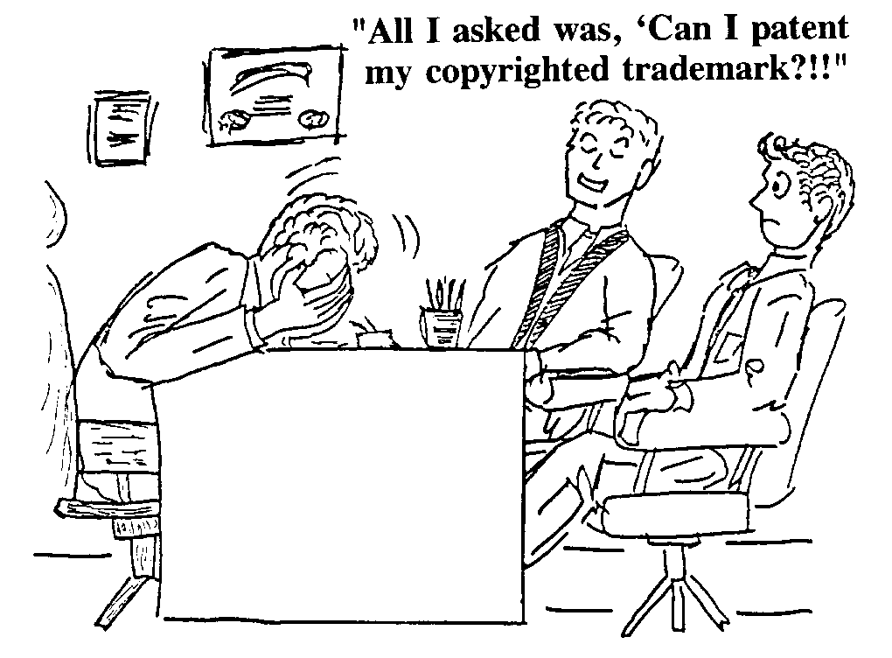
If you don’t see a problem with this question, you need this class!

Slide 3
Types of Intellectual Property
Patents
Trademarks
Copyrights
Unfair Competition
Trade Secrets

Slide 4
How to Acquire Rights
Patents by Application, Examination and Grant
Trademarks & Service Marks by Use in Interstate Commerce, then
registration
Copyright
by writing something -- perfected by declaration and registration

Slide 5
Types of IP a General Practice Attorney is Likely to Encounter
Variants of Trade Secrets
Limited rights in technical data
Restricted rights in computer software
Government purpose rights
special license rights

Slide 6
Types of Patents
Utility
Plant
Design

Slide 7
Utility Patent
Whoever invents or discovers any new and useful process, machine, manufacture, or composition of matter, or any new and useful improvement thereof, may obtain a patent therefor, subject to the conditions and requirements of this title. (35 U.S.C. § 101)

Slide 8
Plant Patents
Whoever invents or discovers and asexually reproduces any distinct and new variety of plant, including cultivated spores, mutants, hybrids, and newly found seedlings, other than a tuber propagated plant or a plant found in an uncultivated state. . . (35 U.S.C. § 161)
No bacteria or similar single-cell organisms need apply!

Slide 9
Design Patents
Whoever invents any new, original, and ornamental design for an article of manufacture may obtain a patent. (35 U.S.C. § 171)

Slide 10
What Is A Patent?
Grant by the U.S. Government to provide individuals legal protection for their discoveries (inventions)
Finds basis in Article 1, Section 8, U.S. Constitution
Congress is empowered to “...promote the progress of science and useful arts by securing for limited times to authors and inventors the exclusive right to their respective writings and discoveries.”
Covered by Federal Law (Title 35 USC)
Gives the patent owner the right to prevent others from making, using or selling the claimed invention within the United States or Country of Issue.

Slide 11
Life & Duration
Life of utility patent - 17 years from date of issue of Patent if application filed before June 95 or 20 years from date of filing application after June 95
Effective only in the U.S. (foreign patent applications filed separately based on U.S. application are available).

Slide 12
INVENTION PATENTABLE IF........
NEW
USEFUL
NOT OBVIOUS
PERTAINS TO PATENTABLE SUBJECT MATTER UNLESS
GRANT OF PATENT IS NOT BARRED

Slide 13
SUBJECT MATTER PATENTABLE
A PROCESS
A MACHINE
A COMPOSITION OF MATTER
A MANUFACTURE
35 USC Section 101

Slide 14
Pop Quiz
Now that you know what type of material is patentable, Answer the following questions.

Slide 15
Questions?
What’s a microbe that eats oil?
What’s a Harvard Mouse?
What’s a method of doing business with a computerized system?

Slide 16
What Does a Patent look Like?

Slide 17
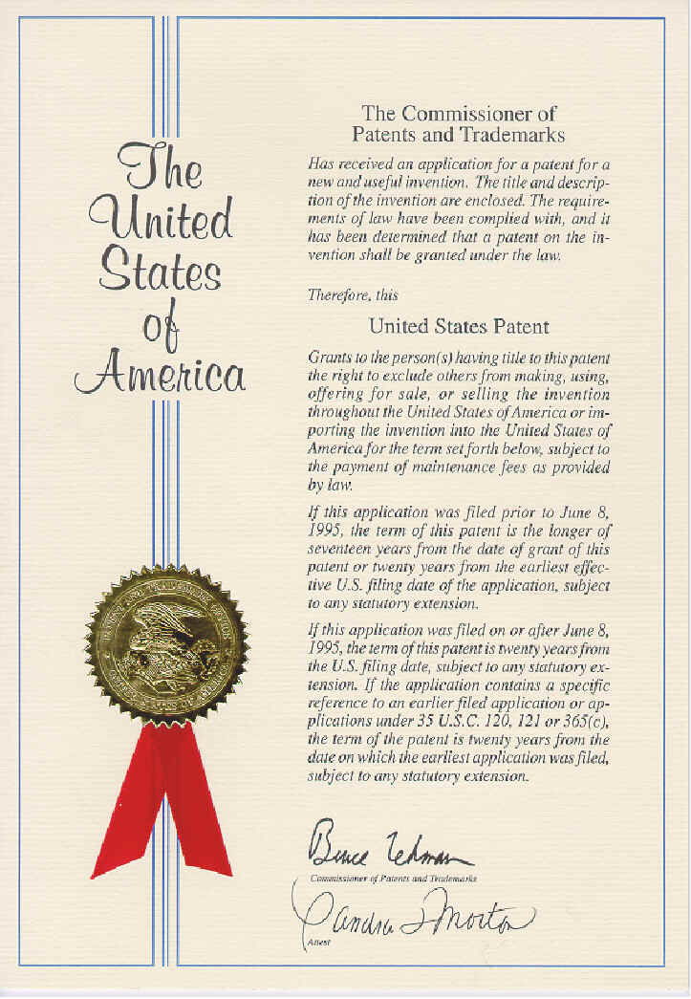

Slide 19
Foreign Rights
PCT Filing within year Acquiring foreign rights from inventor Making the Choice
National Filings
Cost If you have to ask - you can’t afford it

Slide 20
How do we make use of Patents the command accumulates?

Slide 21
LICENSING AND THE GOVERNMENT
Or
How to negotiate a successful partnership.

Slide 22
What is a License?
A contract between licensor and licensee.
Licensor grants to licensee the right to practice the technology claimed in the licensed patent
Licensor agrees not to sue licensee for infringing licensor’s patent

Slide 23
37 C. F. R. PART 404 LICENSING OF GOVERNMENT OWNED INVENTIONS
§ 404.5 Restrictions and conditions on all licenses granted under this part.
(1) A license may be granted only if the applicant has supplied the Federal agency with a satisfactory plan for development or marketing of the invention, or both, and with information about the applicant's capability to fulfill the plan.
(2) A license granting rights to use or sell under a federally owned invention in the United States shall normally be granted only to a licensee who agrees that any products embodying the invention or produced through the use of the invention will be manufactured substantially in the United States.

Slide 24
Other forms of IP!
Trade & Service Marks

Slide 25
Marks
Trademarks® , ™
A trademark identifies tangible good or product of a company or individual.
Servicemarks ®, SM
A service mark identifies the service s of a provider. Marks used by a company can function as both.
^{Trade names}
Once a trade name was used to denote any mark descriptive of a good or service.
Today, it is a company business name.

Slide 26
Acquiring Trademark Rights
Types of trademark
TM - a Trade Mark™ - used before registration
SM - a Service Mark SM - used before registration
Used in Interstate Commerce
Rights by Registration®
Unfair Competition
Misuse of Trade Dress
Passing Off

Slide 27
Can the United States Government Own a Trade/Service Mark?
YES!!!!
TOMAHAWK®
Marine Corp Marathon
NAVYJOBS.COMSM
Let The Journey Begin SM

Slide 28
Can the United States be sued for Trade/Service Mark Infringement?
YES!!!!!
In 1999, Congress removed Federal Government sovereign immunity for trademark infringement including going so far as to allow the US to be sued in State court.
Oh My!!!

Slide 29
Other forms of IP
Copyright©

Slide 30
Copyrights
Copyright law protects the expression of an idea. Not the idea itself.
Copyright protects
“…original works of authorship fixed in any tangible medium of expression, now known or later developed, from which they can be perceived, reproduced, or otherwise communicated, either directly or with the aid of a machine or device.” (17 U.S.C. § 102)

Slide 31
Original
The term original in the copyright law means that the work originated with the author.
There is no requirement for novelty or uniqueness as there is in patent law.
Must originate with author.

Slide 32
Fixed in a Tangible Medium
Any stable medium that will record or reproduce the material is acceptable
Computer software satisfies the fixation the moment the material is stored
a computer display is considered fixed even if it appears momentarily and only returns under certain conditions (games)

Slide 33
Duration
Depends on whether it is pre or post 1 Jan. 1978
Pre - Depends on whether published? Registered, first term, renewal etc.
Post -
Life of author + 50 years
Work-for-hire 75 years from publication, 100 years from creation which ever is first

Slide 34
Ownership
Works for Hire - employer is considered the author when:
work prepared by an employee within the scope or his/her employment
work specially ordered or commissioned for use as a contribution to a collective work
Transfer of title v Work-for-Hire
under a work for hire, employer is considered the owner. Duration 75 years from pub or 100 from creation. Transfer (assignment etc. 35 years)

Slide 35
Ownership cont..
Joint Works - when 2 or more people make contributions of authorship with intention contributions be merged into inseparable work

Slide 36
Government Copyright
17 USC §105 Copyright protection under this title is not available for any work of the United States Government, but the United States Government is not precluded from receiving and holding copyrights transferred to it by assignment, bequest, or otherwise (including contract).
'

Slide 37
Fair Use
Limited use without owners permission
criticism, comment, parody, news reporting, teaching, scholarship or research
criteria
purpose and character of use
nature of original work
amount of work used
extent of harm

Slide 38
Teaching Pop Quiz
Lets Apply the criteria:
Education command wants to reproduce a text book and distribute to all bases and ships at sea. Permissible?
Graphs copied and reproduced in slides will be used in lecture to 150 people. The lecture is going to be video broadcast to all bases and ships at sea. Permissible?

Slide 39
Using IP to Benefit the Lab
Technology Transfer (T²)

Slide 40
Technology Innovation Legislation
Stevenson-Wydler Technology Innovation Act of 1980
Bayh-Dole Act of 1980
Small Business Innovation Development Act of 1982
Cooperative Research Act of 1984
Federal Technology Act of 1986

Slide 41
Technology Innovation (Cont.)
Malcolm Baldridge National Quality Improvement Act of 1987
Executive Orders 12591 and 12618 of 1987
Facilitating Access to Science and Technology
Other Acts Expanding What Can Be Done:
Defense Authorization Acts
National Competitiveness Technology Transfer Act
Department of Commerce Funding Acts

Slide 42
Policy:
15 U.S.C. § 3710 Utilization of Federal technology
“It is the continuing responsibility of the Federal Government to ensure the full use of the results of the Nation’s Federal investment in research and development. To this end the Federal Government shall strive where appropriate to transfer federally owned or originated technology to State and Local Governments and to the private sector.”

Slide 43
Job Description for Researchers!
Each laboratory director shall ensure that efforts to transfer technology are considered positively in laboratory job descriptions, employee promotion policies, and evaluation of the job performance of scientists and engineers in the laboratory.

Slide 44
CRADA = Cooperative Research and Development Agreement
FEDERAL LABRATORY ... Personnel
Services
Property
Patent License Agreement
NON-FEDERAL PARTY... Personnel
Services
Property
$$$Money$$$

Slide 45
The Advantages of a CRADA
.
Participants are able to leverage Resources:
Manpower, Facilities, Funding
Technical problems are solved more effectively by a team effort
Technology base is increased in both organizations.
Federal tax dollars are more effectively utilized

Slide 46
Benefits to the Government Researcher
15 USC 3710c

Slide 47
Why do Government Employees want this?
15 U.S.C. § 3710c Distribution of royalties received by Federal agencies
(iii) The agency or laboratory shall retain the royalties and other payments received from an invention until the agency or laboratory makes payments to employees of a laboratory under clause (i) or (ii).
(B) The balance of the royalties or other payments shall be transferred by the agency to its laboratories, with the majority share of the royalties or other payments from any invention going to the laboratory where the invention occurred. The royalties or other payments so transferred to any laboratory may be used or obligated by that laboratory during the fiscal year in which they are received or during the succeeding fiscal year­­
(i) to reward scientific, engineering, and technical employees of the laboratory, including developers of sensitive or classified technology, regardless of whether the technology has commercial applications;
(ii) to further scientific exchange among the laboratories of the agency;
(iii) for education and training of employees consistent with the research and development missions and objectives of the agency or laboratory, and for other activities that increase the potential for transfer of the technology of the laboratories of the agency;
(iv) for payment of expenses incidental to the administration and licensing of intellectual property by the agency or laboratory with respect to inventions made at that laboratory, including the fees or other costs for the services of other agencies, persons, or organizations for intellectual property management and licensing services; or
(v) for scientific research and development consistent with the research and development missions and objectives of the laboratory.

Slide 48
Why is the Government Involved in this?
Government Research Money is becoming increasingly scarce.
The Old Way won’t work anymore!
Formulate Hypothesis, Accumulate Data, Do Extensive Testing!
The old way...

Slide 49
The NEW Way!
Formulate a hypothesis,
Patent it.
Raise $17 million!

Slide 50
And the Lab Was Not Short of Research Money Anymore
A Fairy Tale
The end
OGC 2000

